Slide 1

Elementary Programming
TUIT
C++ Programming, Fall 2016
Lecture #2
I – part

Slide 2
TUIT
Roadmap
Last week we covered
Introduction to Computers, Programs, and C++
This week we will learn
Introduction
Writing a Simple Program
Reading Input from the Keyboard
Identifiers
Assignment Statements and Assignment Expressions
Named Constants
Numeric Data Types and Operations

Slide 3
TUIT
Introduction
This lecture focused on learning elementary programming techniques to solve problems.
You learned how to create, compile, and run basic programs
You will learn how to solve problems by writing programs
You will learn elementary programming using primitive data types, variables, constants, operators, expressions, and input and output

Slide 4
TUIT
Writing a Simple Program
Writing a program involves designing a strategy for solving a problem and then using a programming language to implement that strategy.
Problem. Computing the area of a circle. How do we write a program for solving this?
Writing a program involves designed algorithms and translating them into programming instructions, or code.
An Algorithm describes how a problem is solved by listing the actions that must be taken and the order of their execution.
Algorithms can help the programmer plan a program before writing in in a programming language
Algorithms can be described in natural languages or in pseudocode (natural language mixed with some programming code).

Slide 5
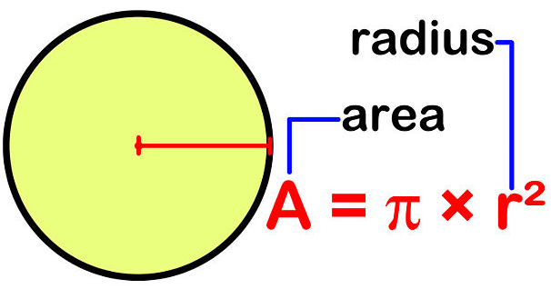
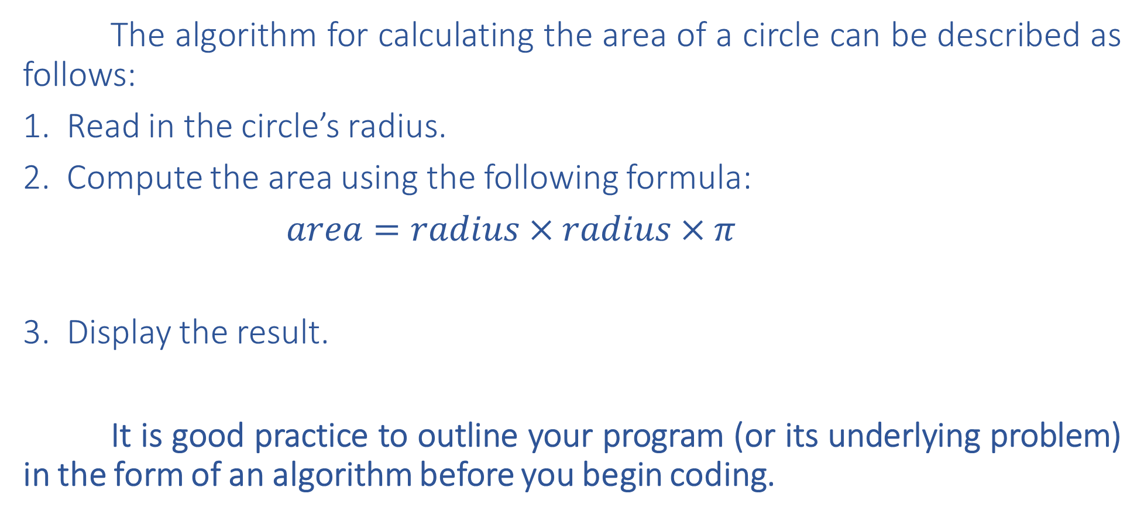
TUIT
Writing a Simple Program
The algorithm for calculating the area of a circle can be described as follows:
Read in the circle’s radius.
Compute the area using the following formula:
$area=radius×radius×π$
Display the result.
It is good practice to outline your program (or its underlying problem) in the form of an algorithm before you begin coding.

Slide 6
TUIT
Writing a Simple Program
When you code – that is, when you write program – you translate an algorithm into a program. You already know that every C++ program begins its execution form the main function. Here the outline of the main function would look like this:
int main()
{
// Step 1: Read in radius
// Step 2: Compute area
// Step 3: Display the area
}
The program needs to read the radius entered by the user form the keyboard. This raises two important issues:
Reading the radius
Storing the radius in the program

Slide 7
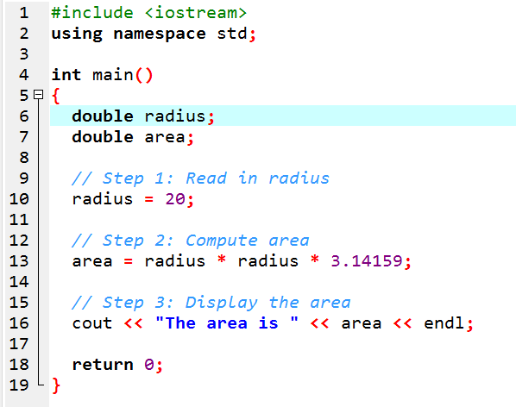
TUIT
Writing a Simple Program
The area is 1256.64

Slide 8
TUIT
Check Point
Show the output of the following code:
double area = 5.2;
cout << “area”;
cout << area;

Slide 9
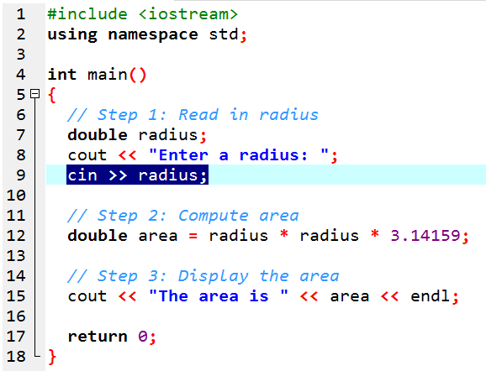


TUIT
Reading Input from the Keyboard
Enter a radius: 2.5 The area is 19.6349
Enter a radius: 23 The area is 1661.9

Slide 10
TUIT
Compute Average
You can use a single statement to read multiple input. For example, the following statement reads three values into variable x1, x2, and x3:
Variables
cin >> x1 >> x2 >> x3;

Slide 11
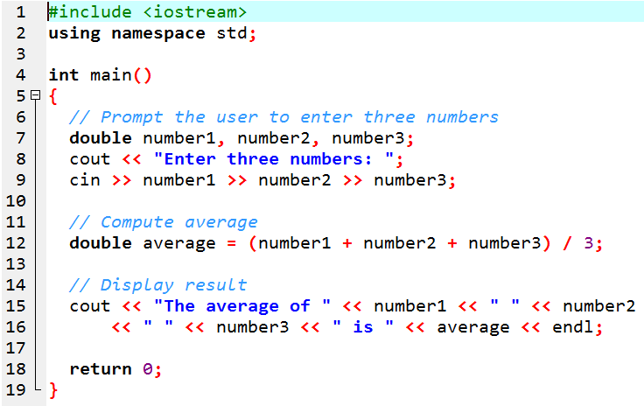
TUIT
Compute Average
Read three numbers and displays their average.
Enter three numbers: 1 2 3 The average of 1 2 3 is 2
Enter three numbers: 10.5 11 11.5 The average of 10.5 11 11.5 is 11

Slide 12
TUIT
Note
Most of the programs in the early lectures of this course perform three steps: input, process, and output called IPO.
Input is receiving input from the user;
Process is producing results using the input;
Output is displaying the results;

Slide 13
TUIT
Check Point
What is the printout if you entered 2 2.5 when executing the following code?
double width;
double height;
cin >> width >> height;
cout << width * height;

Slide 14
TUIT
Identifiers
Identifiers are the names that identify elements such as variables and functions in a program.
As you see in previous program main, number1, number2, number3, and so on are the names of things that appear in the program.
In programming terminology, such names are called identifiers.

Slide 15
TUIT
Identifiers
All identifiers must obey the following rules:
An identifier is a sequence of characters comprising letters, digits, and underscores (…)
An identifier must start with a letter or an underscore; it cannot start with a digit.
An identifier cannot be a reserved word. (C++ Keywords)
An identifier can be of any length, but your C++ compiler may impose restriction. Use identifiers of 31 characters or fewer to ensure portability.
For example, area and radius are legal identifiers, whereas 2A and d+4 are illegal identifiers because they do not follow the rules. The compiler detects illegal identifiers and reports syntax errors.
Since C++ is case-sensitive, area, Area, and AREA are all different identifiers.

Slide 16
TUIT
Check Point
Which of the following identifiers are valid? Which are C++ keywords?
miles, Test, a++, --a, 4#R, #44, apps
main, double, int, x, y, radius

Slide 17
TUIT
Variables
Variables are used to represent values that may be changed in the program.
Variables are used to store values to be used later in a program. They are called variables because their values can be changed.

Slide 18
TUIT
Variables
//Compute the first area
radius = 1.0;
area = radius * radius * 3.14159;
cout << “The area is ” << area << “ for radius ” << radius << endl;
// Compute the second area
radius = 2.0;
area = radius * radius * 3.14159;
cout << “The area is ” << area << “ for radius ” <<radius;
The area is 3.14159 for radius 1.0 The area is 12.56636 for radius 2.0

Slide 19
TUIT
Declare variable
Variables are used to represent data of a certain type. The variable declaration tells the compiler to allocate appropriate memory space for the variable based on its data type.
datatype variableName;
Here are some examples of variable declarations:
int count; //Declare count to be an integer variable
double radius; //Declare radius to be an integer variable
double interestRate;//Declare interestRate to be an integer variable
int i, j, k; //Declare i, j, and k as int variables

Slide 20
TUIT
Initialize variables
int count = 1; equal int count;
count = 1;
int i = 1, j = 2; equal int i(1), j(2);
A variable must be declared before it can be assigned a value

Slide 21
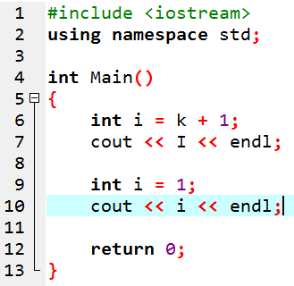
TUIT
Check Point
Identify and fix the errors in the following code:

Slide 22
TUIT
Assignment Statement and Assignment Expressions
An assignment statement designates a value for a variable. An assignment statement can be used as an expression in C++.
After a variable is declared, you can assign a value to it by using an assignment statement. In C++, the equal sign (=) is used as the assignment operator. The syntax for assignment statements is as follows:
variable = expression;
An expression represents a computation involving values, variables, and operators that taking them together, evaluates to a value. For example, consider the following code:
int y = 1; //Assign 1 to variable y
double radius = 1.0; //Assign 1.0 to variable radius
int x = 5 * (3 / 2); //Assign the value of the expression to x
x = y +1; //Assign the addition of y and 1 to x
area = radius * radius * 3.14159; //Compute area

Slide 23
TUIT
Assignment Statement and Assignment Expressions
You can use a variable in an expression. A variable can also be used in both sides of the = operator. For example,
x = x + 1;
In this assignment statement, the result of x + 1 is assigned to x. If x is 1 before the statement is executed, then it becomes 2 after the statement is executed.
To assign a value to a variable, you must place the variable name to the left of the assignment operator. Thus the following statement is wrong:
1 = x; //Wrong

Slide 24
TUIT
Note
In mathematics, x = 2 * x + 1 denotes an equation. However, in C++, x = 2 * x + 1 is an assignment statement that evaluates the expression 2 * x + 1 and assigns the result to x.
cout << x = 1; equal x = 1;
cout << x;
i = j = k = 1; equal k = 1;
j = k;
i = j;

Slide 25
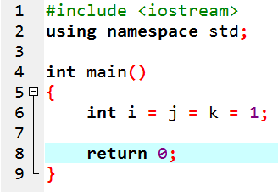
TUIT
Check Point
Identify and fix the errors in the following code:

Slide 26
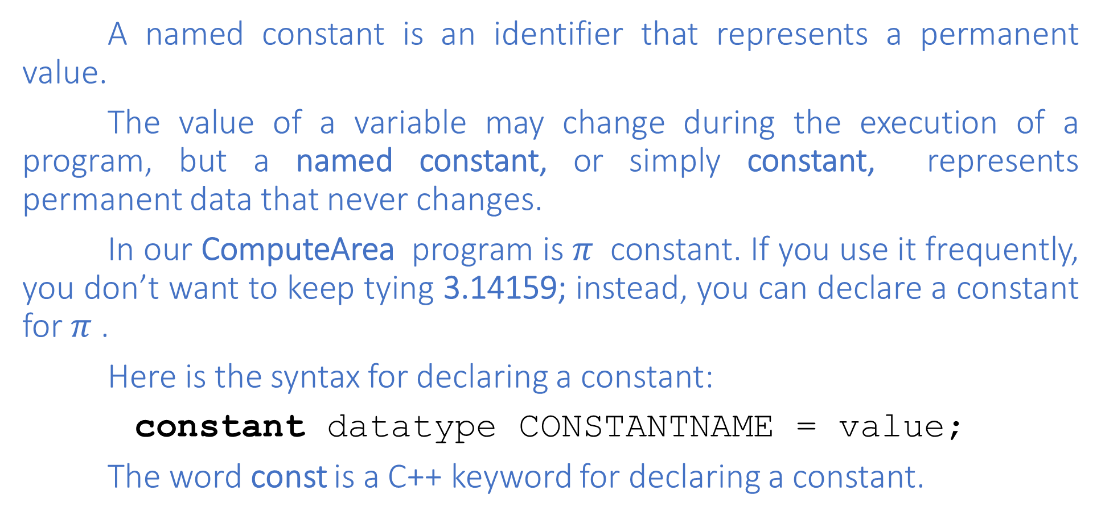
TUIT
Named Constants
A named constant is an identifier that represents a permanent value.
The value of a variable may change during the execution of a program, but a named constant, or simply constant, represents permanent data that never changes.
In our ComputeArea program is $π$ constant. If you use it frequently, you don’t want to keep tying 3.14159; instead, you can declare a constant for $π$ .
Here is the syntax for declaring a constant:
constant datatype CONSTANTNAME = value;
The word const is a C++ keyword for declaring a constant.

Slide 27
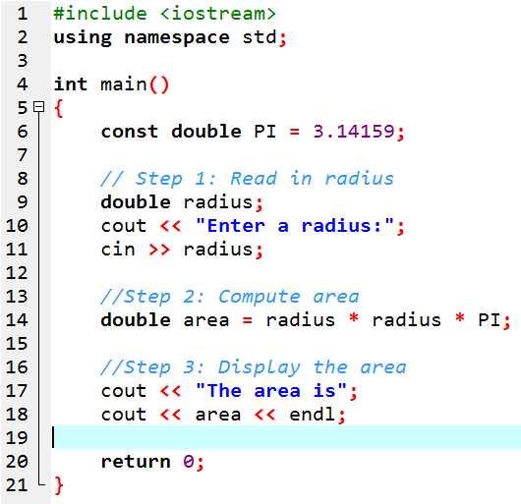
TUIT
Named Constant
Enter a radius: 23 The area is 1661.9

Slide 28
TUIT
Note
There are three benefits of using constants:
You don’t have to repeatedly type the same value;
If you have to change the constant value(e.g. from 3.14 to 3.14159 for PI), you need to change it only in a single location in the source code;
Descriptive constant names make the program easy to read.

Slide 29
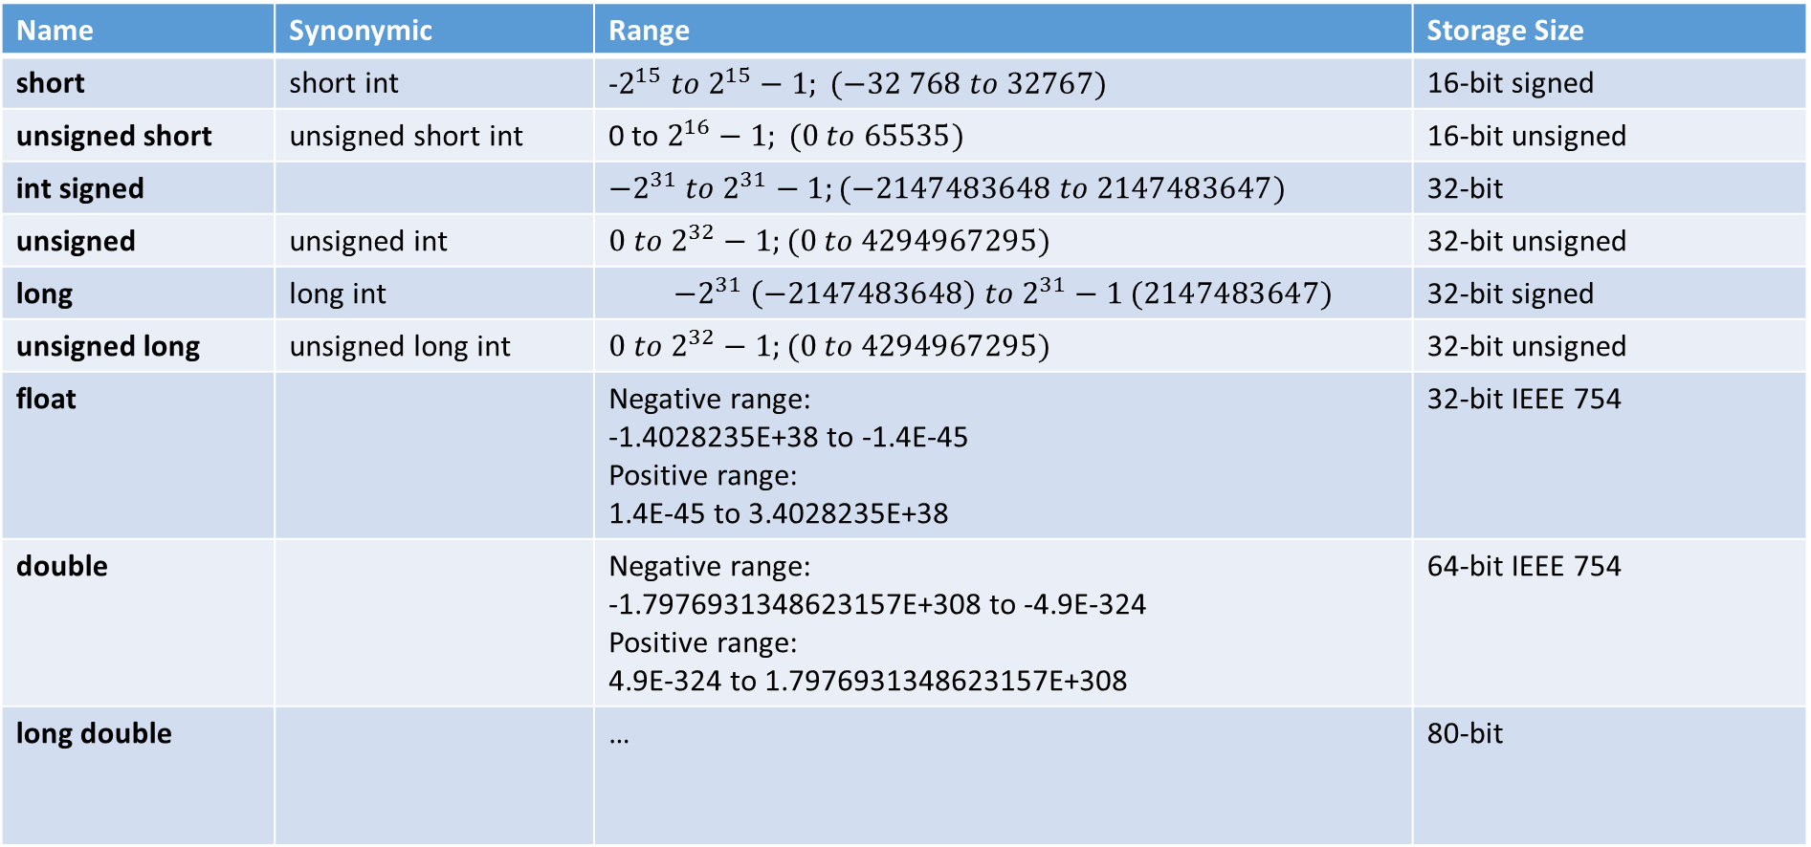
TUIT
Numeric Data Types and Operations
C++ has nine numeric types for integers and floating-point numbers with operators +, -, *, /, and %. Every data type has a range of values.
Name | Synonymic | Range | Storage Size
short | short int | -$2^{15} to 2^{15}−1; (−32 768 to 32767)$ | 16-bit signed
unsigned short | unsigned short int | 0 to $2^{16}−1; (0 to 65535)$ | 16-bit unsigned
int signed |  | $${−2}^{31} to 2^{31}−1;(−2147483648 to 2147483647)$$ | 32-bit
unsigned | unsigned int | $$0 to 2^{32}−1;(0 to 4294967295)$$ | 32-bit unsigned
long | long int | $${−2}^{31} \left(−2147483648\right) to 2^{31}−1 (2147483647)$$ | 32-bit signed
unsigned long | unsigned long int | $$0 to 2^{32}−1;(0 to 4294967295)$$ | 32-bit unsigned
float |  | Negative range: -1.4028235E+38 to -1.4E-45 Positive range: 1.4E-45 to 3.4028235E+38 | 32-bit IEEE 754
double |  | Negative range: -1.7976931348623157E+308 to -4.9E-324 Positive range: 4.9E-324 to 1.7976931348623157E+308 | 64-bit IEEE 754
long double |  | … | 80-bit

Slide 30
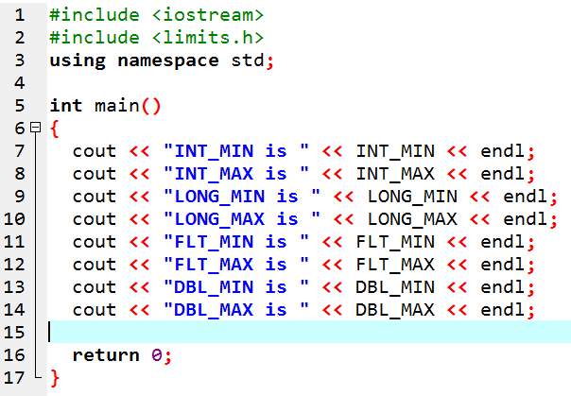
TUIT
Limits
INT_MIN is -2147483648 INT_MAX is 2147483647 LONG_MIN is -2147483648 LONG_MAX is 2147483647 FLT_MIN is 1.17549e-038 FLT_MAX is 3.40282e+038 DBL_MIN is 2.22507e-308 DBL_MAX is 1.79769e+308

Slide 31
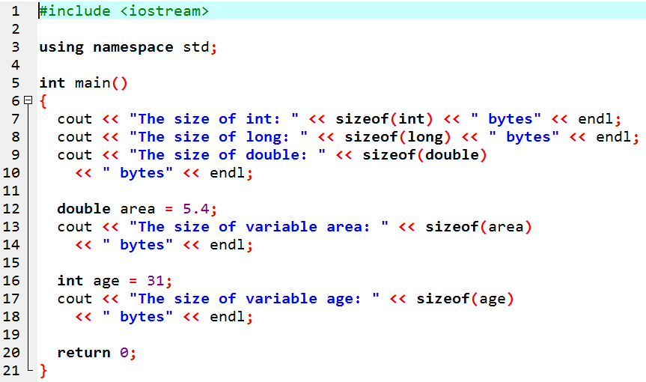
TUIT
sizeof function
The size of int: 4 bytes The size of long: 4 bytes The size of double: 8 bytes The size of variable area: 8 bytes The size of variable age: 4 bytes

Slide 32
TUIT
Numeric Literals
A literal is a constant value that appears directly in a program. In the following statements, for example, 34 and 0.305 are literals:
int i = 34;
double footToMeters = 0.305;
cout << 0xFFFF << “ ” << 010;
cout << 1.23456E2 << “ ” << 1.23456E+2;
cout << 1.23456e-2; << “ ” << 1.23456E-2;

Slide 33
TUIT
Numeric Operators
Operator | Name | Example | Result
+ | Addition | 34 + 1 | 35
- | Subtraction | 34.0 – 0.1 | 33.9
* | Multiplication | 300 * 30 | 9000
/ | Division | 1.0 / 2.0 | 0.5
% | Modulus | 20 % 3 | 2
Dividend
20
13
Divisor
13
1
Quotient
7
Remainder

Slide 34
TUIT
Numeric Operators
If today Saturday, it will be Saturday again in 7 days. Suppose you and your friends are going to meet in 10 days. What day is in 10 days? You can find that day is Tuesday using the following expression:
Saturday is the 6th day in a week
A week has 7 days
(6 + 10) % 7 is 2
After 10 days
The 2nd day in a week is Tuesday

Slide 35
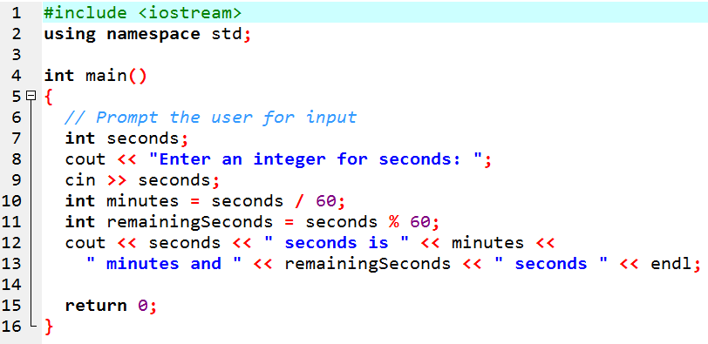
TUIT
Numeric Operators
Enter an integer for seconds: 500 500 seconds is 8 minutes and 20 seconds

Slide 36
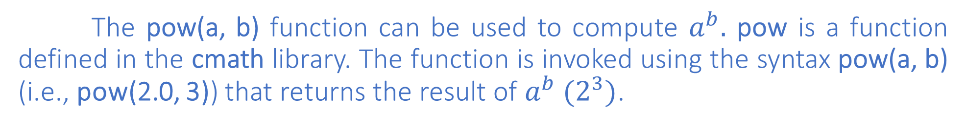
TUIT
Exponent Operators
The pow(a, b) function can be used to compute $a^{b}.$ pow is a function defined in the cmath library. The function is invoked using the syntax pow(a, b) (i.e., pow(2.0, 3)) that returns the result of $a^{b} (2^{3})$.
cout << pow(2.0, 3) <<endl; //Display 8.0
cout << pow(4.0, 0.5) <<endl; //Display 2.0
cout << pow(2.5, 2) <<endl; //Display 6.25
cout << pow(2.5, -2) <<endl; //Display 0.16

Slide 37
TUIT
Check Point
If today is Tuesday, what day will it be in 100 days?

